Slide 1

Fiserv's Credit Buster
Bobby Bonagura
JudexB beaubrun
Kevin Zhu
Tanvi Wagle

Slide 2
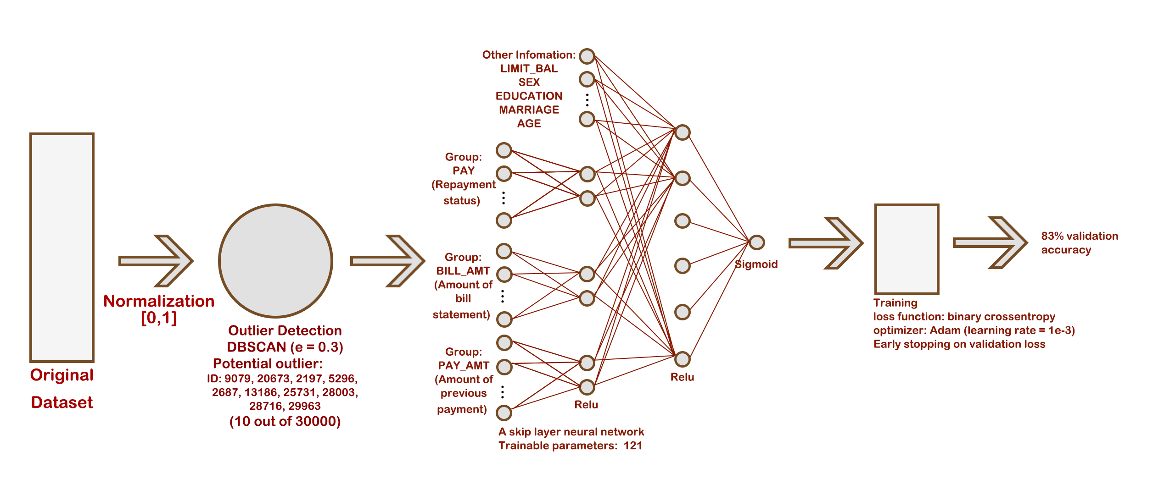
Machine Learning Model

Slide 3
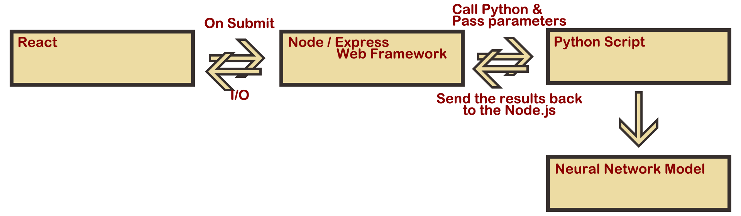
Front-end & Backend Model

